Slide 1

Python
Data structures

Slide 2


Contents
  List
  Tuple
  Set
  Dictionary

Slide 3
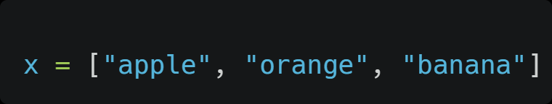
Lists
  A list is a collection of items enclosed in square brackets []
  Lists are ordered, and can be of any type (e.g. integers, strings, etc.)
  Lists are mutable, items can be modified after they are created.

Slide 4
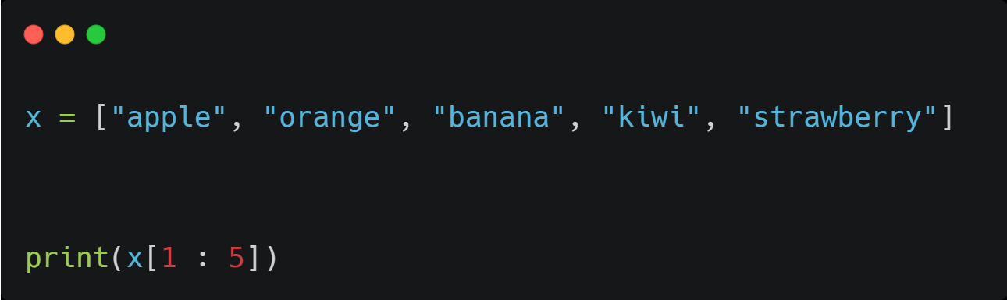
Access a range of index

Slide 5
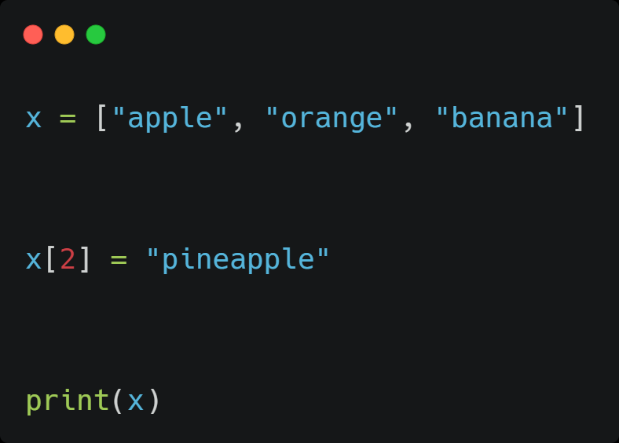
Change items present in list

Slide 6
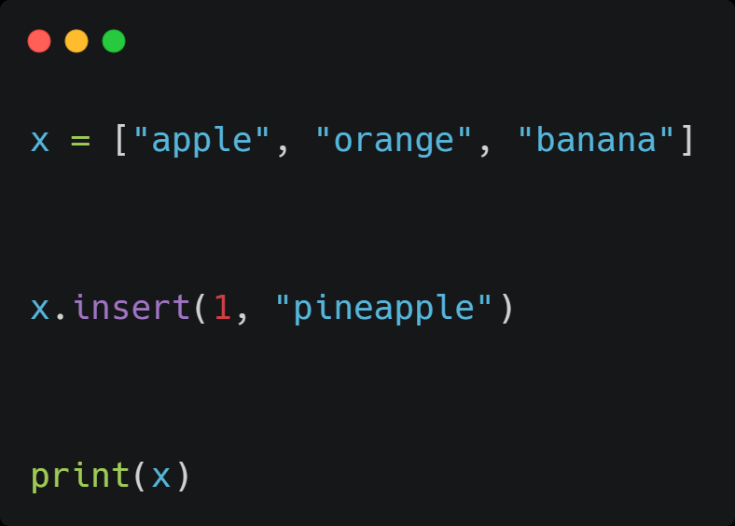
Insert

Slide 7
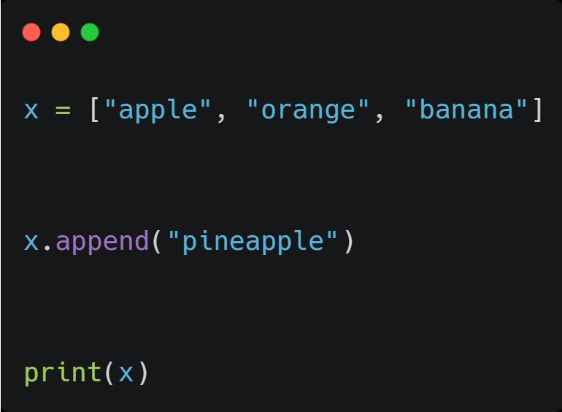
Append
  This will add the specified item in the end of the list

Slide 8
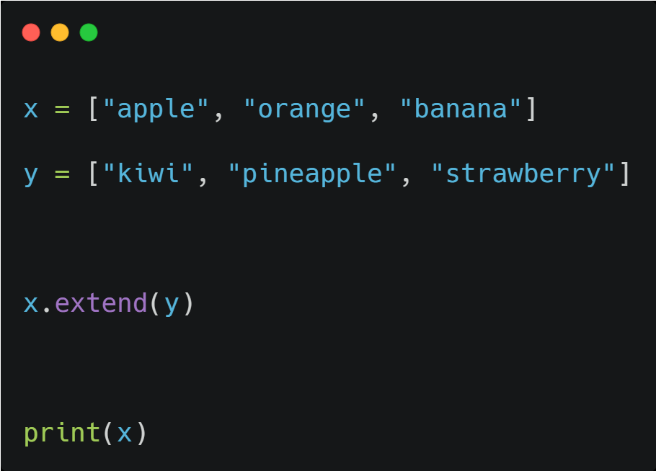
Extend
  This will append elements from another list

Slide 9
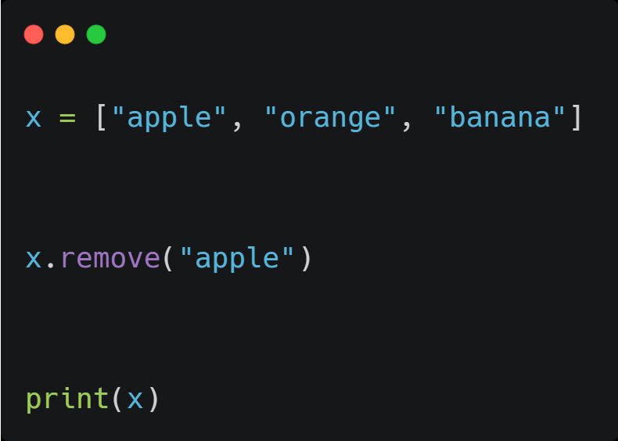
Remove
  Remove specified string from the list

Slide 10
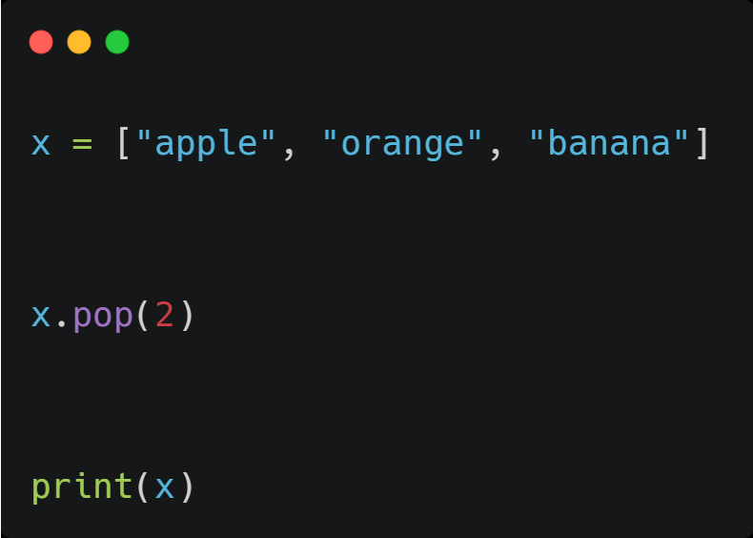
pop
  Remove item present in the specified index

Slide 11
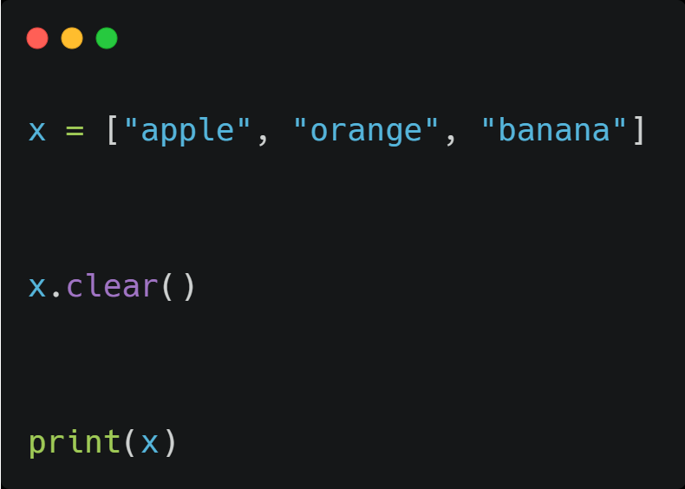
Clear
  Clears the entire list

Slide 12
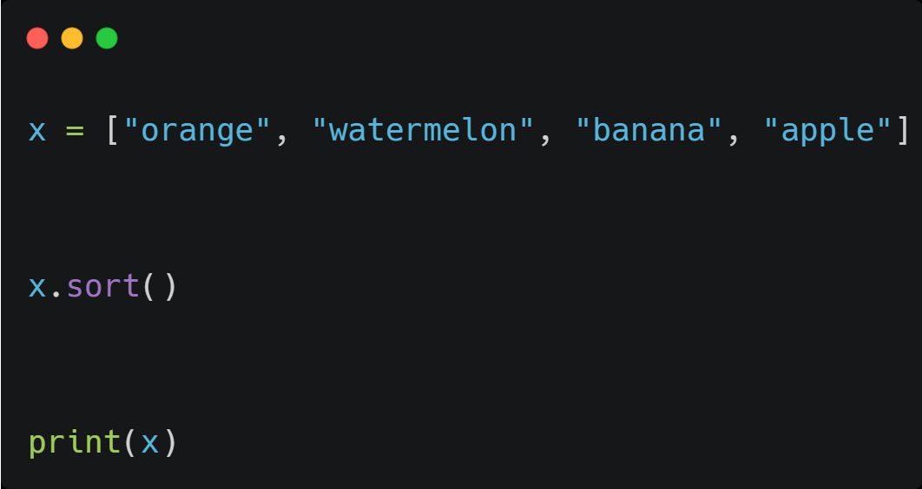
Sorting list
  This will sort the list in alphabetical order, numbers will be sorted in increasing order

Slide 13
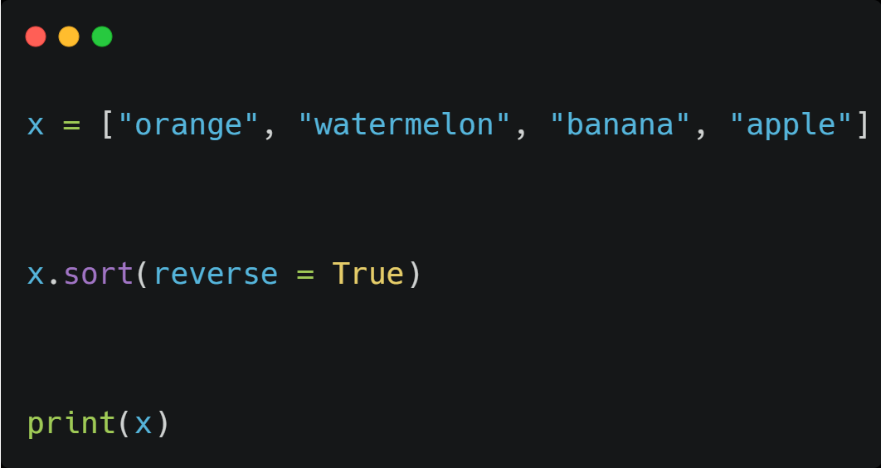
Sort Descending
  This will sort the list in descending order

Slide 14
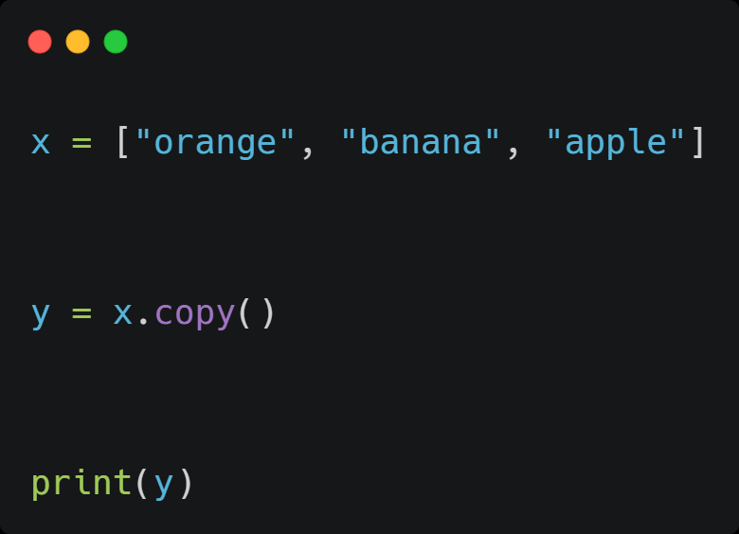
Copy list
  This will create a new list by copying

Slide 15
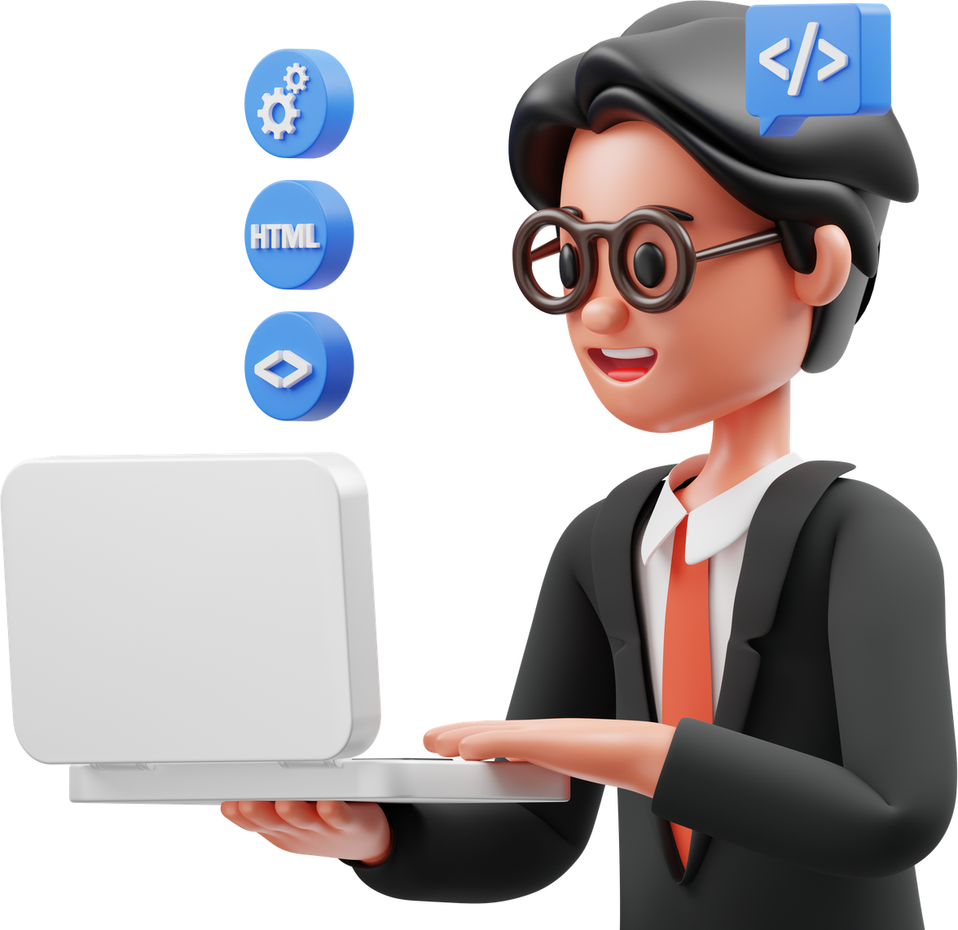
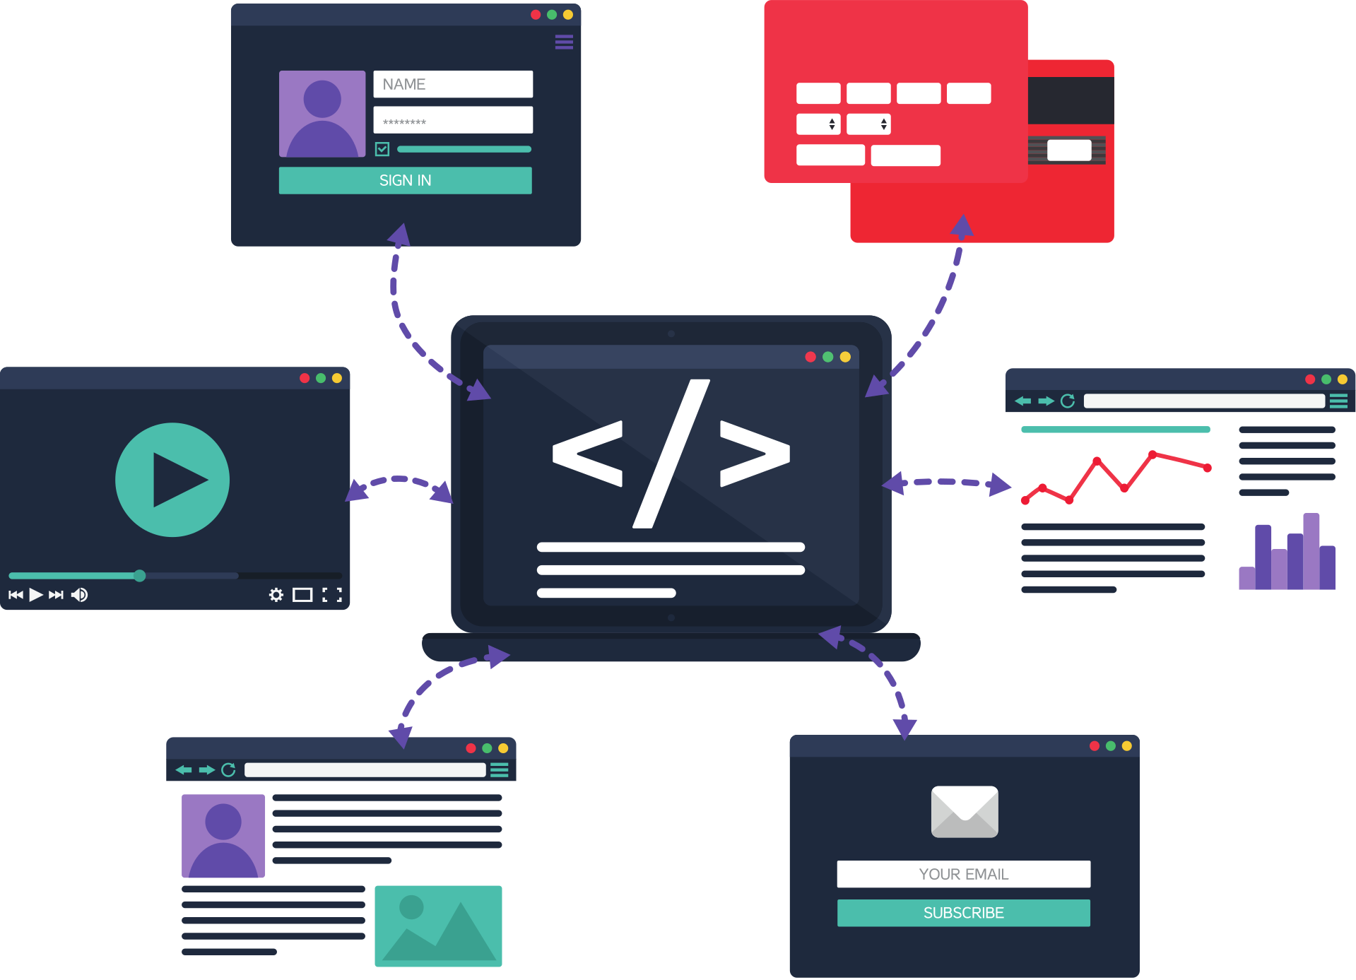
Tuple

Slide 16
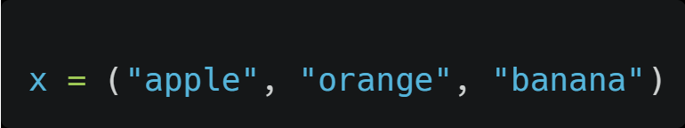
Tuple
  Tuple is a collection of items enclosed in parentheses ()
  Like lists, tuples are ordered and can be of any type.
  However, tuples are immutable, which means that their items cannot be modified after they are created.

Slide 17
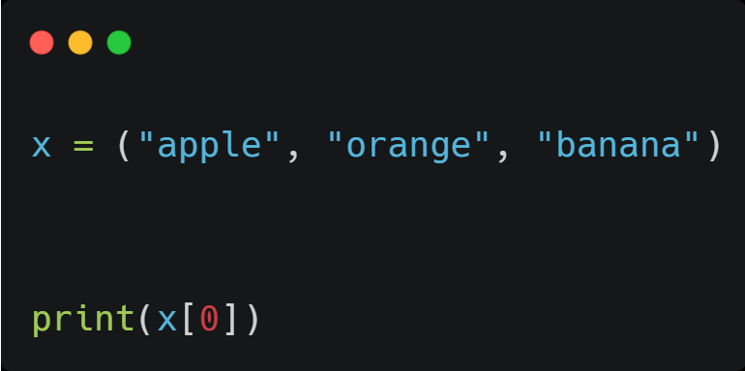
Accessing items in tuple
  Access the items present in a tuple with the help of index number

Slide 18
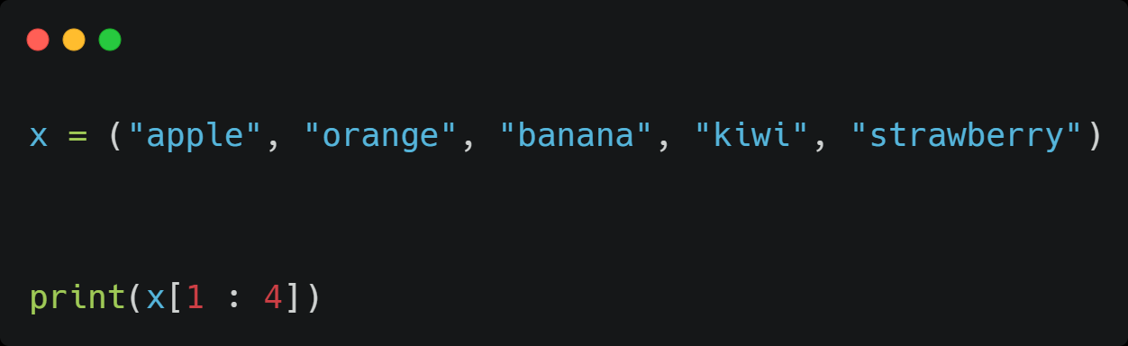
Access a range of index

Slide 19
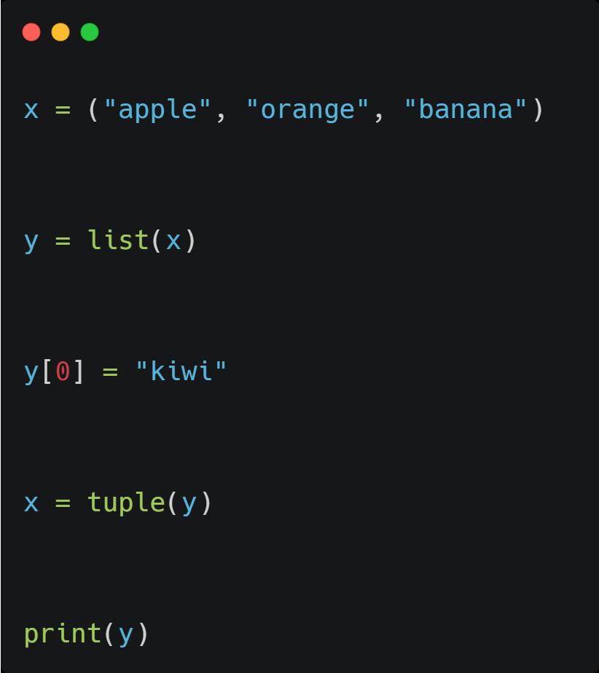
Tuple is immutable
  Changing elements in tuple is not possible, instead,
  Convert tuple into list and then change the item
  Then again convert the changed list back into tuple

Slide 20
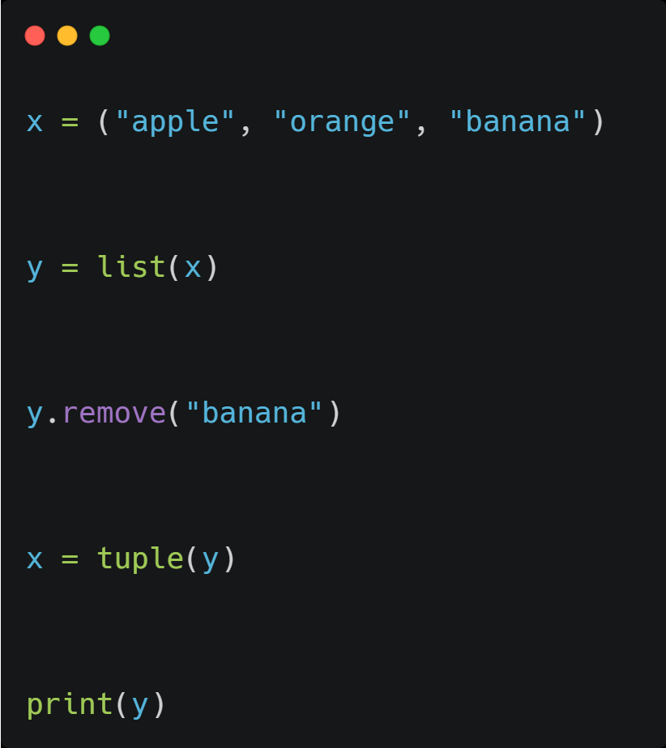
Remove
  To remove specified string from the tuple, convert tuple into a list, then remove and convert back into tuple

Slide 21
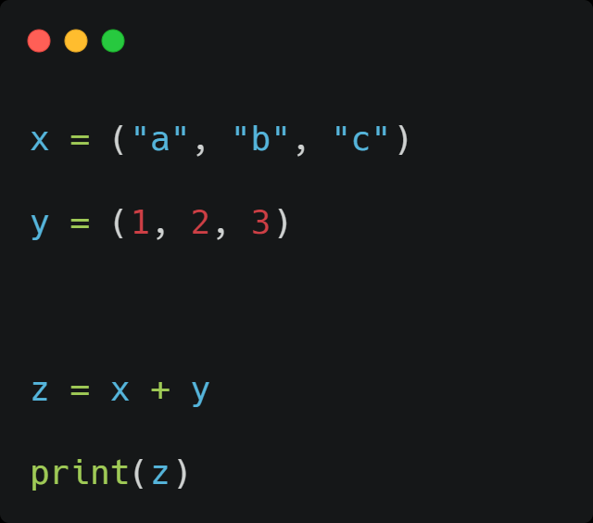
Combine two tuple
  Combine two tuple with the help of "+"

Slide 22

Setset

Slide 23
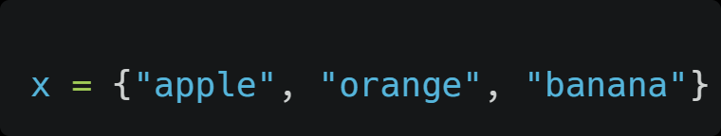
Set
  Set is a collection of unique items enclosed in curly braces {}
  The items in a set have no defined order, and can be of any type
  sets are mutable
  Duplicate is not allowed

Slide 24
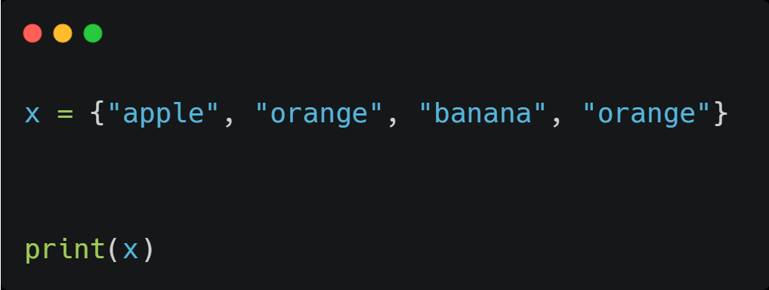
Duplicates will be ignored

Slide 25
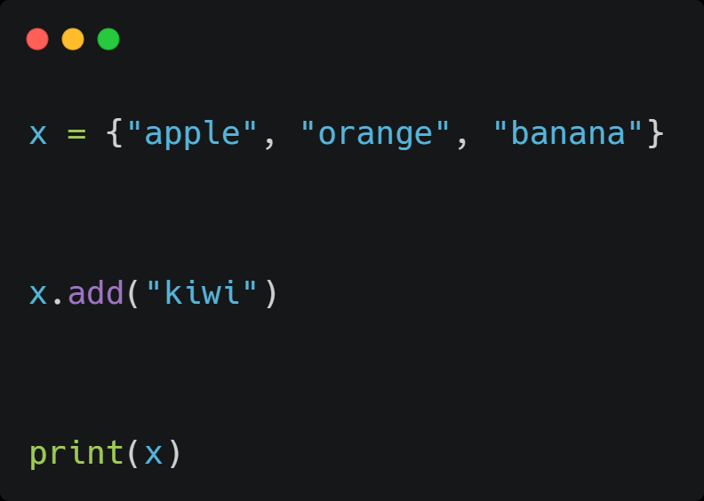
Add
  Use add method to add new items in the set

Slide 26
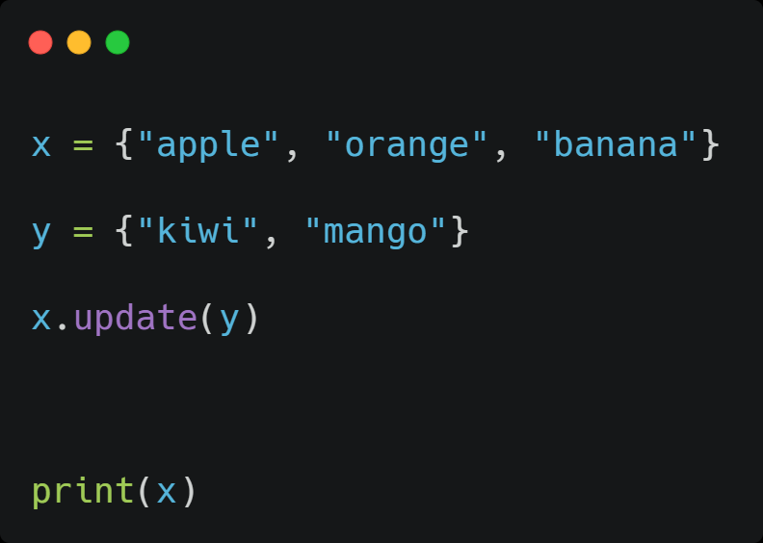
Update
  Use update method to combine two set

Slide 27
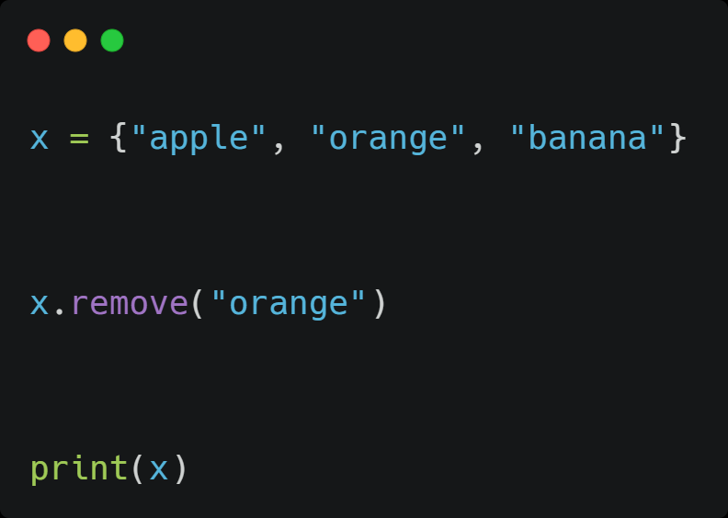
Remove
  Use remove method to remove specified item from set

Slide 28
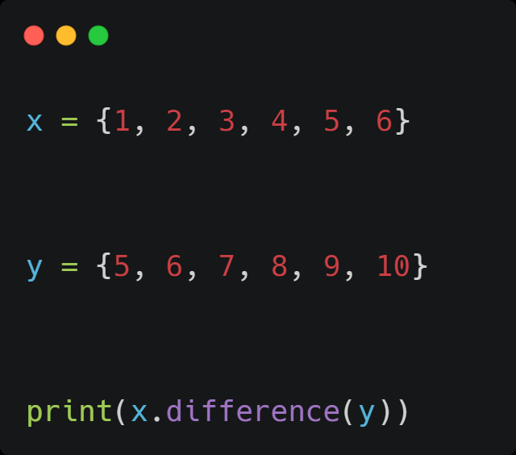
Difference
  To find the values exist in x alone

Slide 29
Difference
  To find the values exist in x alone

Slide 30
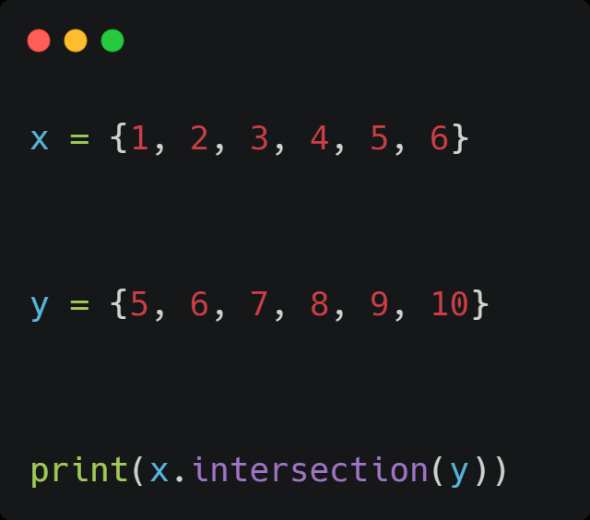
Intersection
  To find common values exist in both

Slide 31
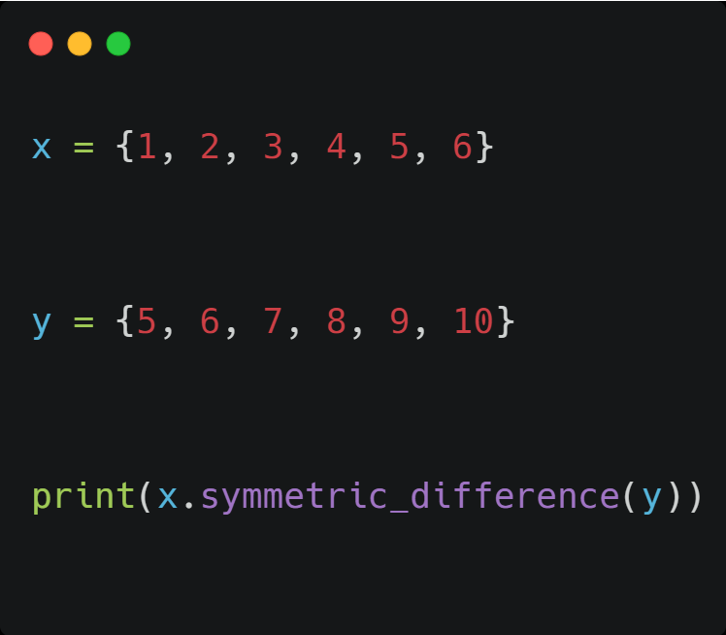
Symmetric difference
  All the items which are not common will be in the output set

Slide 32
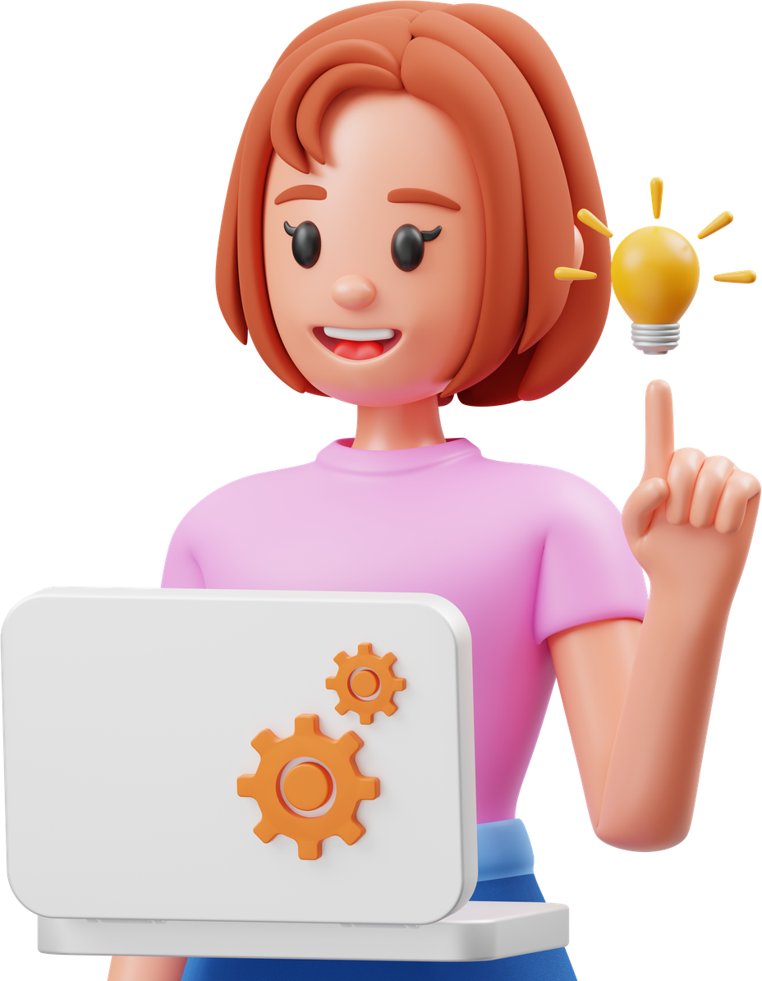
Dictionary

Slide 33
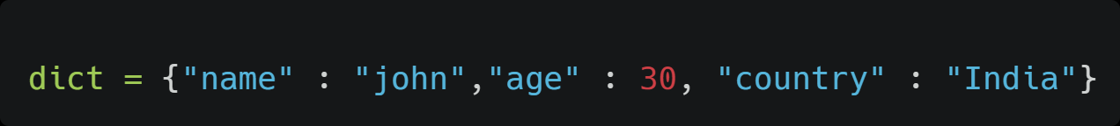
Dictionary
  Dictionary is a collection of key-value pairs enclosed in curly braces {}
  Dictionaries are also mutable, key-value pairs can be added, removed, or modified after they are created.
  Duplicates are not allowed

Slide 34
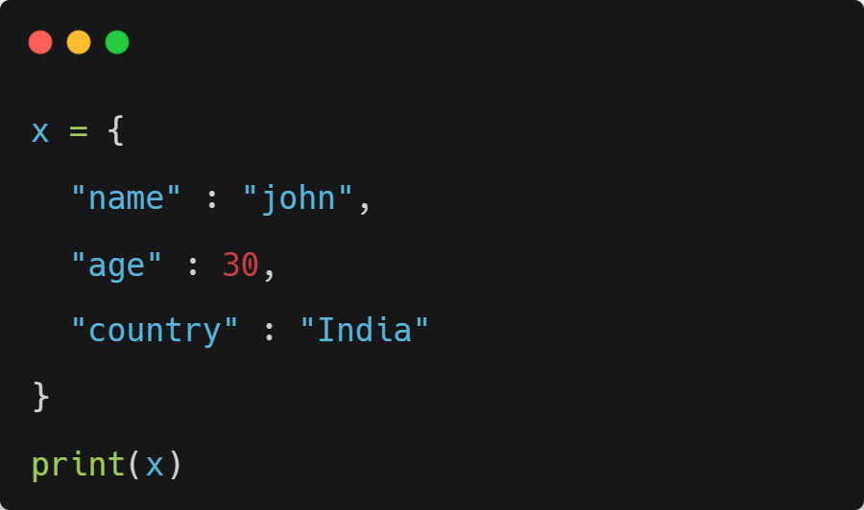
Dictionary

Slide 35
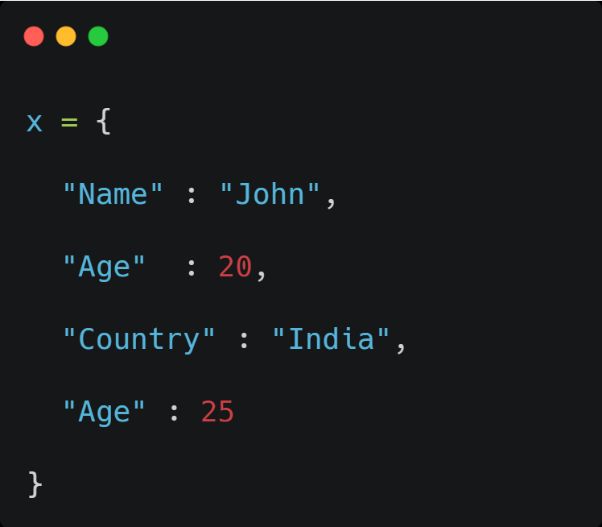
Duplicates are overwritted

Slide 36
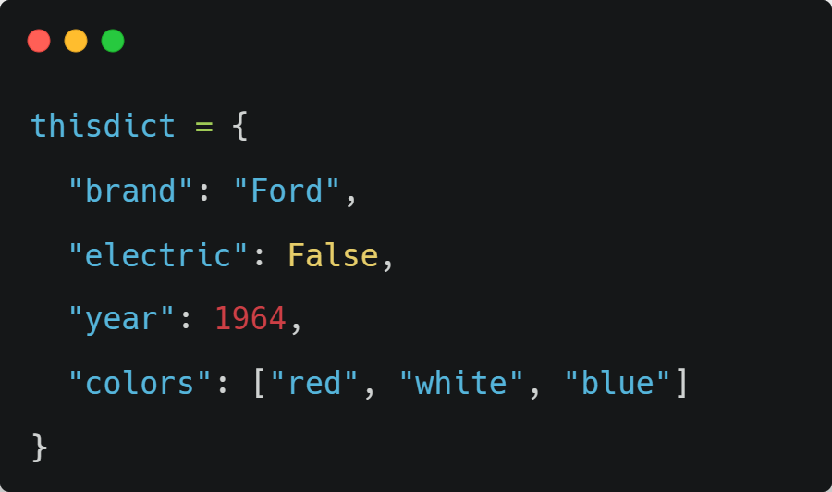
All data types are valid

Slide 37
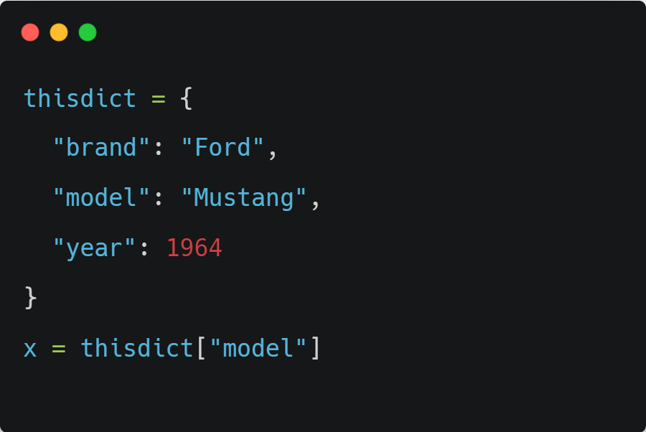
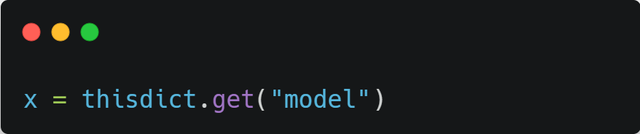
Accessing dictionary

Slide 38
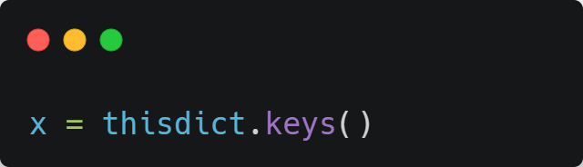
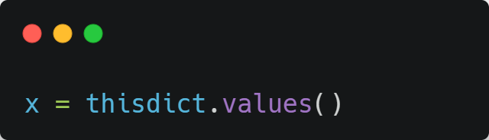
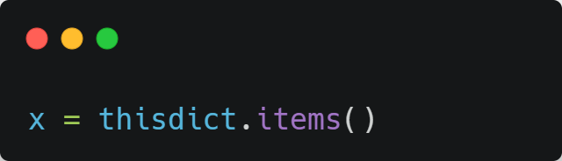
Accessing dictionary
.KEYS()
.VALUES()
.ITEMS()

Slide 39
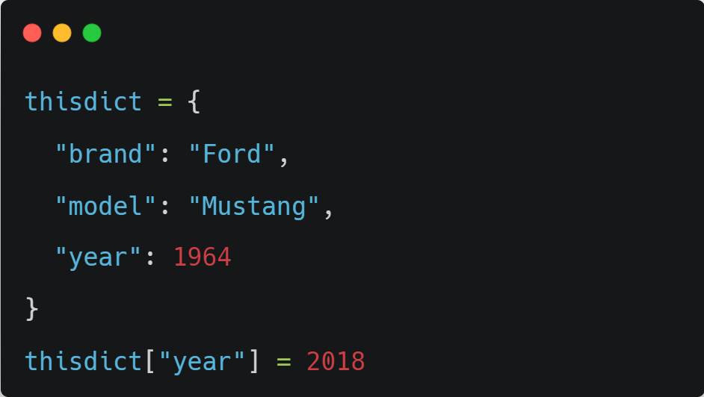
Changing values

Slide 40
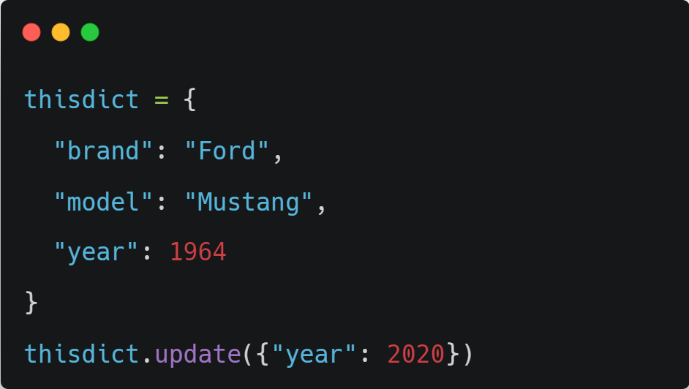
Update method

Slide 41
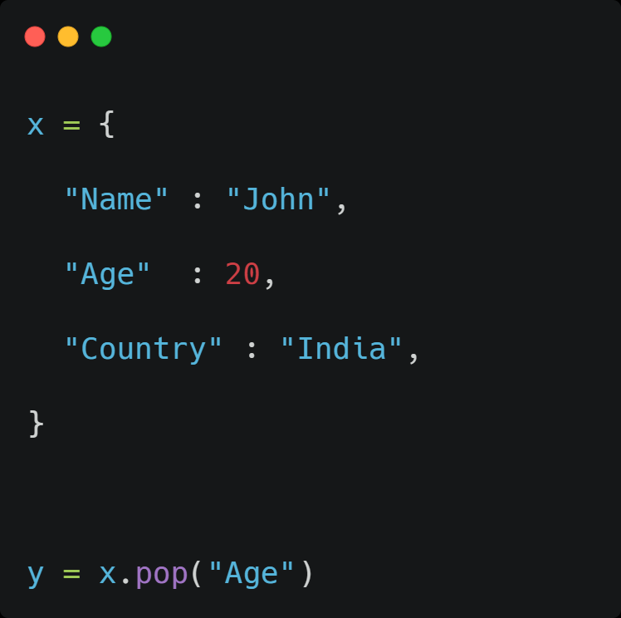
Pop

Slide 42
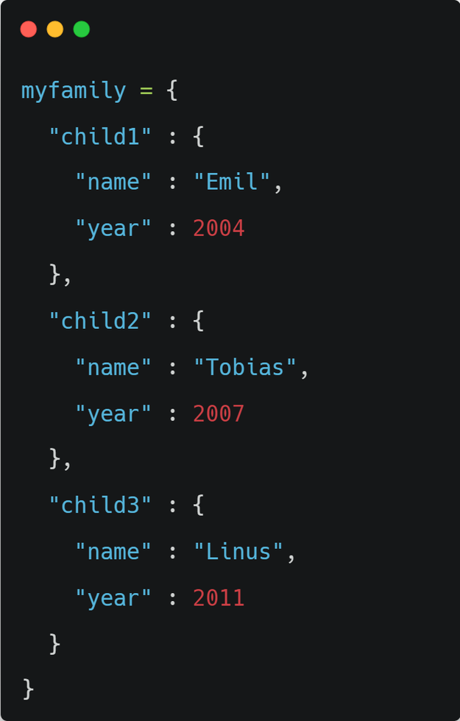
Nested Dictionary

Slide 43
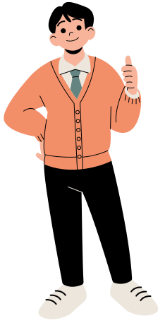


Slide 44





My Time
just a simple reminder
Don't use rude words when you're in a bad mood,
because you will have many chances to change your mood but
you will never get an opportunity to take back what you said.........
Pantech elearning

Slide 45

MY TIME
MOTIVATION FOR YOU AND ME
Travel is not pretty
it isn’t always comfortable. Sometimes it hurts, it even breaks your heart.
But that’s okay.
The journey changes you;
it should change you.
It leaves marks on your memory, on your consciousness, on your heart, and on your body. You take something with you. Hopefully, you leave something good behind.”

